Slide 1
Static Keyword In java

Slide 2
What is Static ?
In Java, static keyword is mainly used for memory management.
• It can be used with variables, methods, blocks, and nested classes.
• It is a keyword which is used to share the same variable or method of a given class. Basically, static is used for a constant variable or a method that is same for every instance of a class.
• It means single copy storage.

Slide 3

Initialization Process
At a high level, the JVM performs the following steps:
First, the class is loaded and linked. Then, the “initialize” phase of this process processes the static variable initialization. Finally, the main method associated with the class is called.

Slide 4
Storage Area of Static Variables and Method
The static variables and methods are stored in the heap memory. In fact all static methods are stored in the Heap memory.
Before the Java 8 version, static variables of the class were stored in the separate section of the non-heap memory named as Method Area created by the Java Virtual Machine after the class compilation. Method area section was used to store static variables of the class, metadata of the class, etc. Whereas, non-static methods and variables were stored in the heap memory.

Slide 5
How static keyword helps in memory management?
The main purpose of using the static keyword in Java is to save memory. When we create a variable in a class that will be accessed by other classes, we must first create an instance of the class and then assign a new value to each variable instance – even if the value of the new variables is supposed to be the same across all new classes/objects.
But when we create a static variable, its value remains constant across all other classes, and we do not have to create an instance to use the variable. This way, we are creating the variable once, so memory is only allocated once

Slide 6
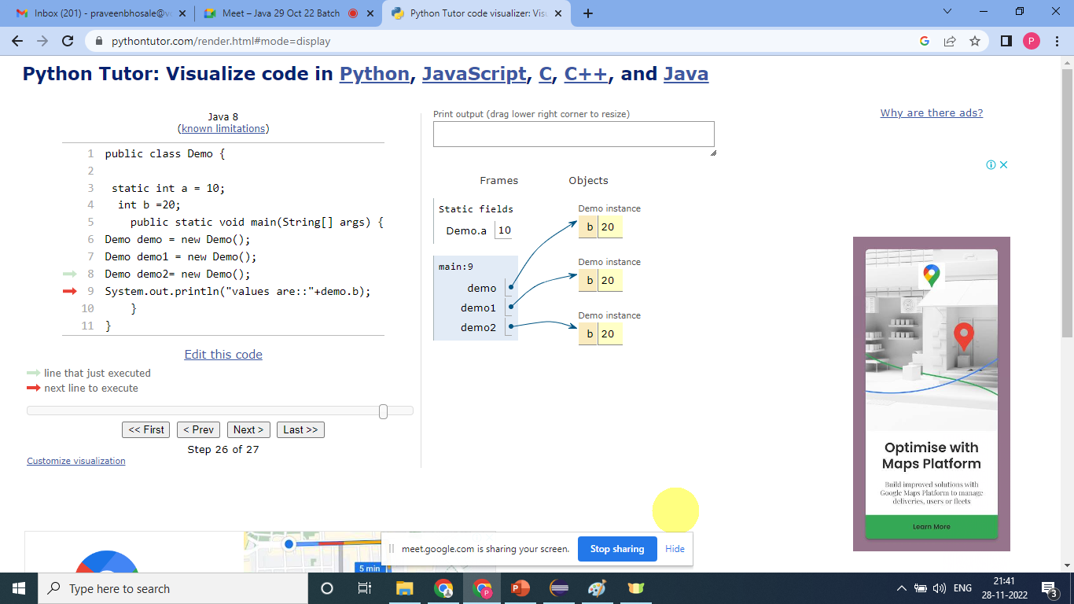

Slide 7
Static Variable
A variable which is defined with static keyword called as “static variable.”
It is used to refer the common property of all the objects.
Static variables get loaded into memory at the time of class loading.

Slide 8
How to access static variable.
1. By using class name
2. By using object name. (Don’t use this you know why!)
3. Direct calling

Slide 9
Code…

Slide 10
Why it is called as single copy storage?
Memory allocation for a static variable happens only once in the class area when the class is loaded in the memory. It is also known as a class variable. It is common to all the objects of the class. In this, a single copy of a static variable is created and shared among all the objects of the class.

Slide 11
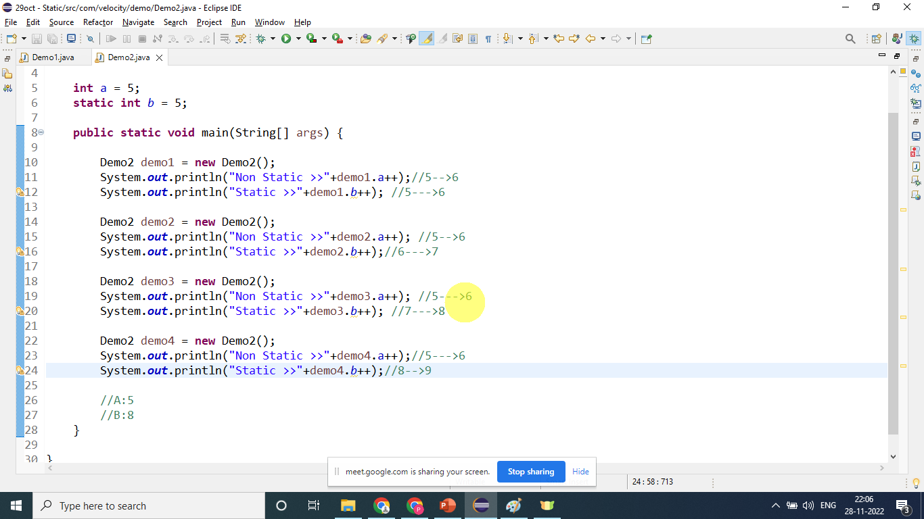
Code….

Slide 12
Static Method in java
If you define any method with static keyword, then it is called as static method.
It belongs to class rather than object of class.
It loads into memory before object creation.
It can access only static data member only.
Note: - Main method is static method Static

Slide 13
Static block in java
It is group of statements that are executed when class is loading into memory by Class loader.
It is widely used to create the static resource.
We cannot access non-static variable into static block.
It is always executed first.
Note- Outer class cannot be static but inner class can be static.
Note- Constructor cannot be static.

Slide 14
When to use which type :
Static Variable:
You can use Static Variables to save memory or in an operation where you want all threads to maintain one variable instead of having a different variable for every thread.
Static Method:
Used when methods are more relevant to class than an instance of a class. Or common behavior needs to be shared by all objects.
Static Block:
Used when you want to initialize any data before the execution control goes to other methods like the main method.

Slide 15
Important Learning Points from Static
Static variables are shared across all instances of a class. Static variables are associated with the class rather than with the objects.
Static variables are loaded at the time of class compilation.
Static variables can be used in any type of methods: static or non-static.
Non-static variables cannot be used inside static methods. It will throw a compile-time error.
Static variables are memory efficient as they are created only once per class. They are not created separately for each instance like instance variables.
Static variables can be accesed using either the class name or instance name. However, it is recommend to access static variables using the class name.

